Slide 1

Human Machine Image Based Dialog
Author: Omar Alaa
Supervised by: Prof.Dr. Mohamed Salem
GERMAN UNIVERSTIY IN CAIRO
Notes:
Hello everyone, my name is Omar Alaa and today I am gonna give a presentation about an interesting topic which is the human machine image based dialog and this presentation is supervised by professor mohamed salem.

Slide 2
Introduction
Methodology
CONTENT
Results
Conclusion
Notes:
so before starting here's a quick overview of how the presentation will go thru so i will be starting by an introduction about the topic then ill move to the methodology section and followed by the results and finally the conclusion

Slide 3
Introduction
1
Notes:
so now lets start the introduction

Slide 4
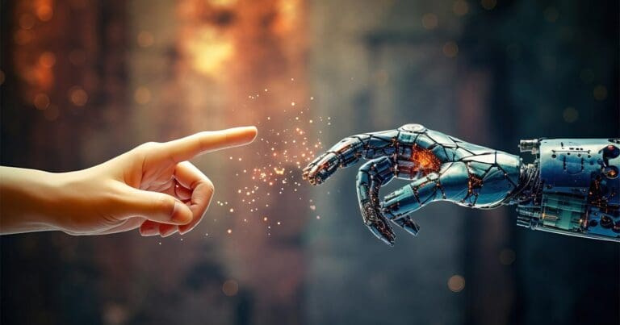
Introduction
The WHAT
The WHY
Objectives
2
Notes:
as previously said the topic is called human machine image based dialogue so for any topic to be discussed the audience must be aware of two things the what and the why
the what is what is the topic or what does it stand for and the why is why would it be crucial to address such a topic so this is whats gonna happen through the introduction then ill be moving to describe the presentation objectives

Slide 5
HMIBD
Interaction between Humans and Machines in terms of Technology and AI.
Human Machine
Image Based Dialog
Integration of visual content into communication.
3
Notes:
so starting by the what
what is HMIBD so obviously HMIBD stands for human machine image based dialogue and human machine here is basically a term referring to the interaction between humans and machines and the image based dialogues are integration of visual content into communication so the term human machine image based dialogue stands for the interaction between humans and machines based on integrating visual content into communication forms

Slide 6
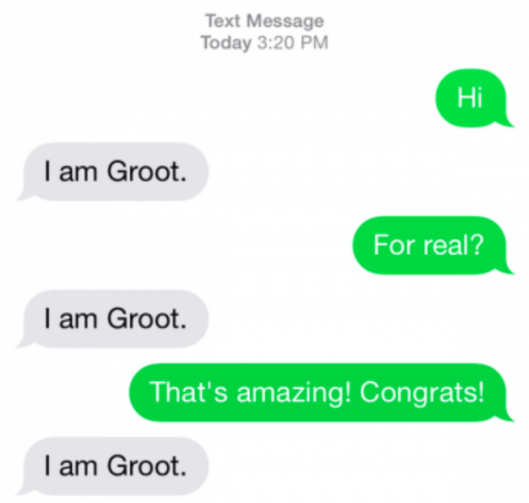
Motivation
Addressing Accessibility Challenges
Advancing Technology
Enhanced User Experience
4
Notes:
moving to the why part so the why is the motivation to address such a topic so my motivation was based on these 3 points
first one is addressing accessibility challenges as some people having disabilities or struggling with traditional text based interfaces the image based dialogue should be solving this issue
secondly, this topic represents a frontier in artificial intelligence research and development. By pushing the boundaries of computer vision, natural language processing, and machine learning, researchers can unlock new capabilities and drive innovation in the field of human-computer interaction.
and the last point is that by integrating images into dialogue with machines, we can create more engaging and intuitive user experiences.
so as you can see in this screenshot if you haven't watched avengers endgame yet this is a message in groot language, groot was a tree and he spoke nothing but the groot language basically the language is "I am Groot" so if you don't speak groot you will never be able to respond to these messages but the question is what if groot was using image based interface to talk and communicate

Slide 7
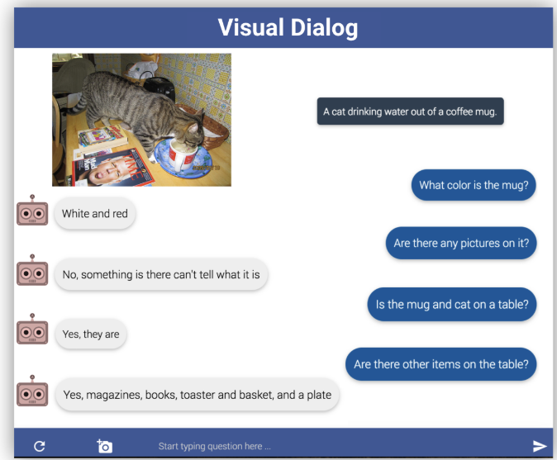
Objectives
Visual Dialog
Define Visual Dialog Task
Introduce Evaluation Metrics
Define Challenges
Highlight Applications
5
Notes:
Moving to the objectives part, I am going to present the paper Visual Dialog addressing this topic so by the end of this presentation you should be able to understand the task that the researchers were doing as i am gonna define it as well as introducing the evaluation metrics and highlight the challenges faced thru the implementation process
so as a quick example this is a screenshot captured from the model so the user is basically chatting with an agent and asking questions about a photo sent in the chat and the agent is just answering by analyzing the information in this picture

Slide 8
Introduction
Methodology
CONTENT
Results
Conclusion
Notes:
so now moving to the methodology part.

Slide 9
Methodology
6

Slide 10
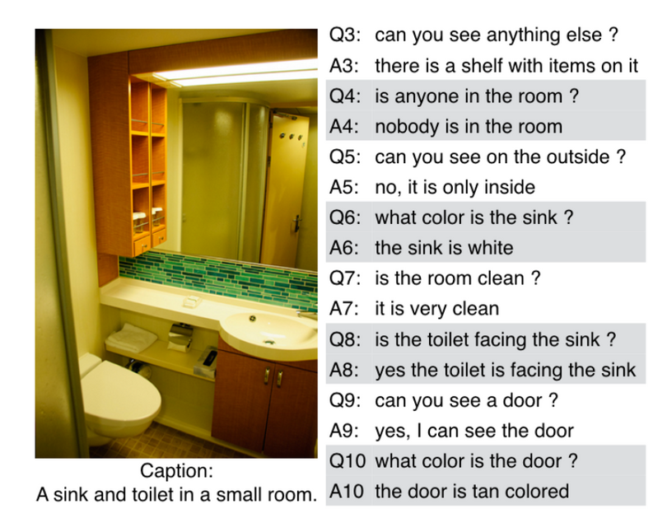
Methodology
Dataset
VisDial & VQA Datasets
Training
Testing
Validation
Data Collection
Model Architecture
Training Procedure
Testing Procedure
7
Notes:
In this section I will explain the implementation details from a high perspective so starting by the data collection step then defining the model architecture then the training and testing processes
so starting by the dataset, VisDial dataset was utilized and was separated into training data, validation data and testing data so the dataset basically was decomposed of an image and a given input text dialog

Slide 11
Model Architecture
network processes the input image to extract visual features using CNNs pretrained on image classification tasks.
Image Encoder
network processes the textual input (questions) to extract semantic features using RNNs.
Question Encoder
The history of dialogue exchanges is encoded to capture the context of the conversation.
History Encoder
A decoder network generates a response based on the encoded image, question, and dialogue history.
Answer Decoder
8
Notes:
and now moving to the model architecture this model consists of 3 encoders and a decoder so the first encoder is the image encoder and its task is to process the input images and extract the necessary features and information from it
secondly the question encoder and this one is processing the input text to extract features the user is inquiring about
then the third encoder is the history encoder and this one is keeping the dialogue history to capture and memorize the context of the conversation for future responses
and finally the answer decoder which generates the response based on the information gathered from the encoded image, question and dialogue history

Slide 12
Training
1) Supervised Learning.
2) Reinforcement Learning.
Supervised
Reinforcement
Classification: Considering the prediction of discrete class labels for answers to questions as each answer in the VisDial dataset represents a discrete class label.
The model learns to generate more effective dialogues by optimizing the dialogue generation strategy based on the received feedback. This allows the model to improve its performance over time and generate more coherent and relevant responses in dialogue based interactions about visual data.
Regression: Considering the prediction of continuous numerical values for answer probabilities.
9
Notes:
and this takes us to the further step which is the training procedure so this model was trained using the 2 techniques the supervised and reinforcement learning
and the supervised part the model was trained on both classification and regression so the classification was aiming to predict the different labels for answers to the questions asked as each answer in the dataset is representing a class label
and the regression part is to predict the continuous numerical values for the answer probability
moving to the reinforcement learning so the model learns to generate dialogs by optimizing the dialog generation strategy based on the given feedback

Slide 13
Training Steps
1. Data Preparation: Tokenization of textual inputs (questions and answers), resizing and normalization of images, and creating input-output pairs for the model.
2. Model Initialization: The model architecture components are initialized with pretrained weights.
3. Forward Pass: During each iteration of training, a batch of training instances is fed into the model then each encoder does its task and the encoded features from the image, question, and history encoders are concatenated and fed into the answer decoder.
4. Training Iterations: The training process iterates over multiple epochs, with each epoch consisting of multiple batches of training data.
10
Notes:
and the training steps were as follows:
firstly the authors prepared the data by tokenizing the input texts and creating input-output pairs for the model
then they initialized the architecture components with pretrained weights
then during each iteration, a batch of training data is fed into the model and when the encoded features come out they are concatenated and fed into the decoder
and for the training iterations, each step was iterating on multiple epochs with multiple batches of the training data

Slide 14
Testing
Evaluation on Unseen Data: This phase involves evaluating the model on a separate set of data that the model has not been exposed to during training.
Prediction Process: During testing, each instance of unseen data (consisting of an image and dialogue history) is fed into the trained model then the model generates responses to questions about the images based on the learned dialogue generation strategy.
11
Notes:
so now for the testing phase, the model was tested on unseen data and the prediction was given as response to each question based on the learned dialog generation strategy

Slide 15
Introduction
Methodology
CONTENT
Results
Conclusion
Notes:
and this takes us to the next section of the presentation which is the results

Slide 16
Results
12
Notes:
so now lets discuss the results

Slide 17
Results & Evaluation
Answer Lengths and Distribution:
Mean-length comparison: VisDial (2.9 words) vs. VQA (1.1 words)
Cumulative coverage comparison: VisDial (63%) vs. VQA (83%).
Classification accuracy comparison: VisDial (73.3%) vs. VQA (52.8%).
Model accuracy on VisDial: 93.3%.
13
Notes:
So in terms of the results, the authors used the mean length or the average number of words in the answers provided in each dataset so the average number of words in VisDial was 2.9 words while in VQA it was 1.1 words and as we can notice there's a relatively high difference between both so what the average number 2.9 in VisDial is indicating is that there are more words which represents a more detailed and elaborative answers coming from the VisDial dataset which ensures better performance than that of VQA
and secondly there was also the cumulative coverage comparison and this measures the extent to which a certain number of more frequent or more repeated answers are covering the total answer space in the dataset
so in VisDial the top 63% of the most frequent answers cover the total answer space while in VQA there's higher cumulative coverage, with the top 83% of the most frequent answers covering the total answer space, suggesting a higher concentration of common answers and potentially less variability in responses compared to VisDial.
and the authors have measured and calculated the model performance on VisDial dataset and they stated the accuracy as 93.3%

Slide 18
Coreference in Dialogs
Aspect | VisDial | VQA
Questions Containing Pronouns | 38% | 9%
Answers Containing Pronouns | 19% | 15%
Dialogs Containing Pronouns | 98% | 63%
14
Notes:
also this table here was used in evaluating the model performance in terms of pronouns so the VisDial dataset had 38% of the questions containing pronouns while the VQA one had 9% and for the answers containing pronouns, VisDial had 19% while VQA had 15%
and Dialogs containing pronouns in the VisDial were around 98% while in VQA they were 63%
so the usage of this comparison indicates that the higher occurrences of pronouns in the VisDial dataset compared to VQA suggest potentially more challenging dialogue contexts that require sophisticated language understanding and generation capabilities from the model.

Slide 19
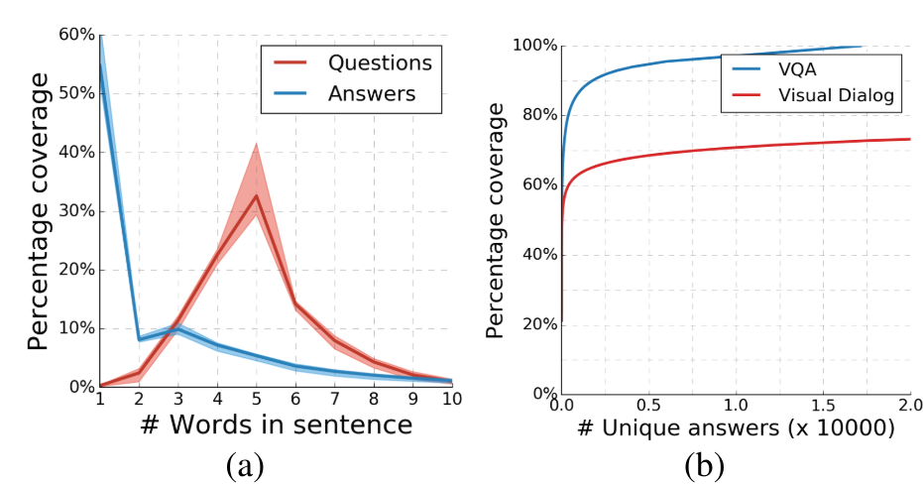
Evaluation Graphs
15
Notes:
and now these graphs are helping evaluating the model performance on the VQA dataset so here in the graph on the left, Percentage Coverage vs. Words in Sentence we can notice that as the length of the sentence increases the coverage decrease which makes sense why the model couldn't perform well on VQA dataset

Slide 20
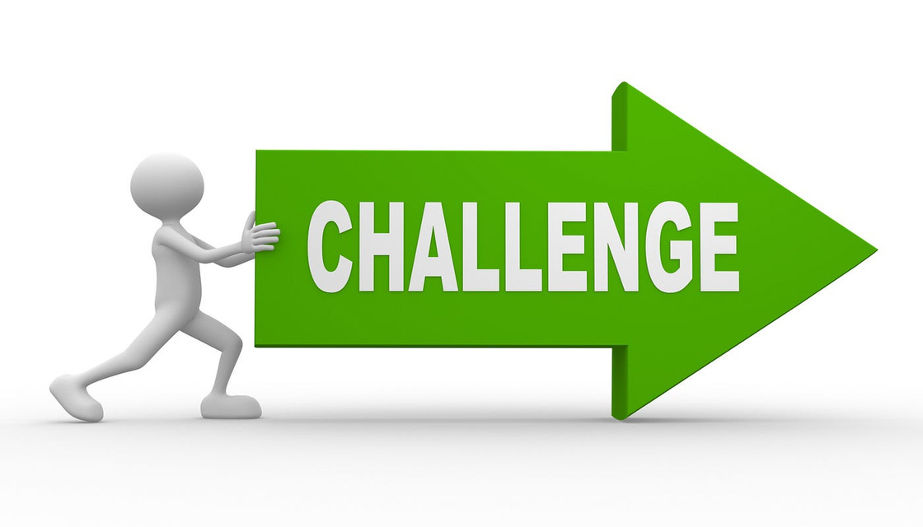
Challenges
Model Complexity
Data Collection
Bias and Fairness
Real World Deployment
16
Notes:
and now with the last part in the results i would like to explain the challenges faced during implementation of this model
so first of all the model complexity, as developing the model requires addressing the challenges of context understanding, and natural language generation, which can lead to complex model architectures and training procedures.
secondly the data collection, building large-scale datasets with high-quality annotations is challenging and often requires significant human effort and resources for data collection and annotation.
third point is bias and fairness so ensuring that the model is not biased towards specific demographics or subject to unfair biases in its responses requires careful consideration and mitigation strategies during model development and training.
and last point is real world deployment as it requires overcoming challenges related to scalability, robustness, and user interaction design to ensure seamless integration and satisfactory user experiences.

Slide 21
Introduction
Methodology
CONTENT
Results
Conclusion
Notes:
so now let's move to the final section in this presentation the conclusion

Slide 22
Conclusion
17

Slide 23

Conclusion
Summary 2. Applications
Summary
Defining Human Machine Image Based Dialog Concept
Identifying the Motivation
Covering the Objectives
Explaining the Methodology Steps
Showing and evaluating the Results
Highlighting Challenges
18
Notes:
the conclusion section will be divided into these 2 parts, first one is a summary or a quick recap for today's presentation and the second one is defining some real life applications
so to sum up what i have explained today in this presentation, i started by the introduction defining the human machine image based dialog concept and the motivation to work on this topic then i explicitly introduced the objectives of this presentation then i explained the methodology steps including the dataset, model architecture, training and testing phases then i have discussed the results of the model and finally i highlighted the challenges faced the authors while working on this project so now before i step off i would like to give some real life applications for using this model

Slide 24
Applications
Virtual Assistants: Enhancing virtual assistants ability to understand and respond to user queries based on both texts and images.
Educational Tools: Facilitating interactive learning experiences, where students can ask questions about images and receive informative responses.
E-commerce: Allowing users to ask questions about products based on images, enabling more personalized and informative interactions.
Healthcare: In medical imaging analysis, this model can assist healthcare professionals by providing explanations and insights based on visual data, aiding in diagnosis and treatment planning.
19
Notes:
so the first application is virtual assistants and using the visual dialog model helps them understanding the user needs based on the given texts and images
secondly it is helpful to use in education due to providing interactive learning experience such that students can retrieve information about specific images using this model
and for the e commerce part, it allows users to gather information about the products based on these images
and finally it is used in healthcare in imaging analysis assisting in giving explanations and insights aiding the diagnosis and treatment planning

Slide 25
References
Das, A., Kottur, S., Gupta, K., Singh, A., Yadav, D., Moura, J. M. F., Parikh, D., & Batra, D. (2017) - Visual Dialog.
20
Notes:
the conclusion section will be divided into these 2 parts, first one is a summary or a quick recap for today's presentation and the second one is defining some real life applications
so to sum up what i have explained today in this presentation, i started by the introduction defining the human machine image based dialog concept and the motivation to work on this topic then i explicitly introduced the objectives of this presentation then i explained the methodology steps including the dataset, model architecture, training and testing phases then i have discussed the results of the model and finally i highlighted the challenges faced the authors while working on this project so now before i step off i would like to give some real life applications for using this model

Slide 26


